Slide 1


Hotel Revenue Analysis (2018–2020)
This comprehensive data analytics project examines hotel booking patterns, revenue trends, and operational performance across a three-year period from 2018 through 2020. The analysis leverages booking data to identify revenue opportunities and operational inefficiencies.
Presented By: TEAM C
Om Bokare Rinisha Shajitha Rinal Dave Mihira Sri
Aditi Sahu
Alekhya Rethiga
Project Mentor: Selciya

Slide 2


Problem Statement
Project Context
The hospitality industry faces increasing pressure to optimize revenue while maintaining guest satisfaction. Hotel operators need to understand booking patterns, seasonal trends, and pricing strategies to maximize profitability. Without comprehensive data analysis, revenue management decisions remain reactive rather than proactive.
Core Challenges
Revenue management decisions based on limited historical data
Difficulty identifying high-value customer segments
Challenges in optimizing room pricing strategies
Limited visibility into booking lead times and cancellation patterns
Need for data-driven insights to guide capacity planning

Slide 3






Project Objectives: A Strategic Roadmap
This analysis was designed to address five critical business questions that would guide strategic decision-making for hotel management. Each objective was carefully crafted to extract maximum value from the available data.
Analyze Revenue Trends
Examine temporal patterns in revenue generation across different time periods, seasons, and market conditions to identify growth opportunities and risk factors.
Study Booking Behavior
Understand how customers book rooms, their lead times, booking channels, and cancellation patterns to optimize reservation strategies.
Understand Customer Segmentation
Identify distinct customer groups based on demographics, booking patterns, and spending behavior to enable targeted marketing approaches.
Evaluate Pricing Strategies
Analyze average daily rates, revenue per available room, and pricing elasticity across different segments and time periods.
Generate Actionable Insights
Transform data findings into concrete recommendations that hotel management can implement immediately to improve performance metrics.

Slide 4


Dataset Overview: The Foundation of Analysis
Comprehensive Data Coverage
The dataset spans three years (2018-2020),
capturing a complete business cycle that includes
seasonal variations and year-over-year performance.
This temporal breadth enables trend analysis and year-to-year comparisons.
The data encompasses both city hotels and resort
properties, providing insights into different market segments and operational models.
Key data elements include booking details, revenue
figures, average daily rates, occupancy rates,
market segments, customer types, booking channels, and stay durations.
This comprehensive coverage allows for multi-
dimensional analysis across various business dimensions.
3
Years of Data
2018-2020 coverage
86.8K
Total Bookings
Complete reservation records
$30.5M
Revenue Generated
Accumulated earnings
3.5
Average Stay
Days per booking

Slide 5

Data Preprocessing
Raw booking data requires extensive preparation before analytical analysis can commence. The preprocessing phase ensures data quality, consistency, and analytical readiness through systematic cleaning and transformation procedures.
01 02 03
Data Cleaning
Remove irrelevant fields, correct inconsistent naming conventions, and standardize data formats across all attributes to ensure uniformity.
Missing Value Handling
Identify and address missing data points through appropriate imputation methods or exclusion criteria based on data importance and pattern analysis.
Duplicate Removal
Detect and eliminate duplicate booking records that may skew analytical results and create artificial inflation in metrics.
04
05
Data Transformation
Create derived attributes such as booking lead time, revenue per booking, and customer tenure to enhance analytical capabilities.
Calculated Measures
Develop business logic calculations using DAX including occupancy rates, revenue per available room, and customer lifetime value metrics.

Slide 6
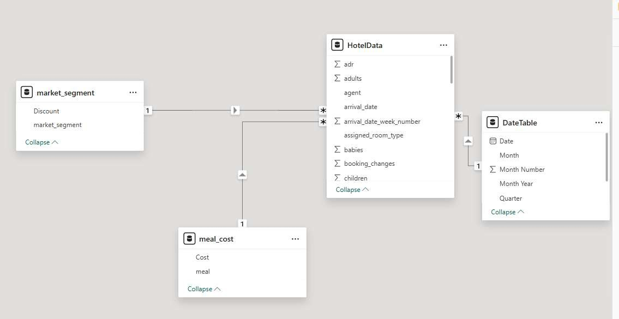

Data Modeling
Model Architecture
The data model establishes relationships between booking facts and dimension tables including customer demographics, room types, and temporal attributes. Calculated measures enable revenue analysis across multiple dimensions.
Key Components
Fact table storing booking transactions
Dimension tables for customer attributes
Temporal dimensions for time-based analysis
Room type and property classifications
Booking channel and source tracking

Slide 7

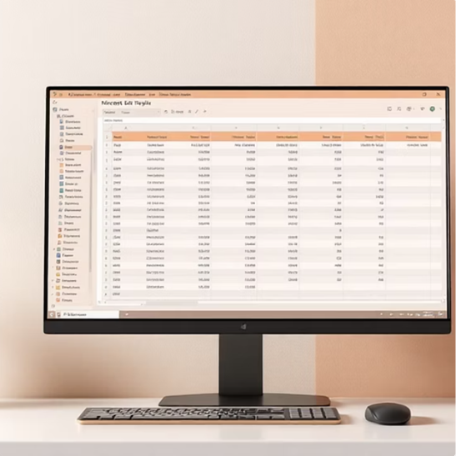


Tools and Technologies
Power BI
Primary platform for dashboard creation, interactive visualization, and business intelligence reporting. Enables drag-and-drop analytics and enterprise-grade data connectivity.
Microsoft Excel
Initial data handling, exploratory analysis, and data preparation tasks. Provides flexible environment for data manipulation and preliminary statistical analysis.
DAX (Data Analysis Expressions)
Calculation language for creating custom measures, KPIs, and business logic. Enables complex analytical computations and time-intelligence calculations.

Slide 8

Dashboard Architecture
The analytical solution comprises four interconnected dashboards, each designed to address specific business questions while maintaining consistent visual design and data integration. This multi-dashboard approach enables users to drill from high-level executive summaries to detailed operational insights seamlessly.
Executive Overview
High-level revenue metrics, booking performance, and occupancy trends for C-level decision-makers. Includes year-over-year comparisons and key performance indicators.
Booking Behavior Analysis
Detailed examination of customer booking patterns, channel performance, lead time analysis, and cancellation rates. Reveals customer decision-making processes.
Revenue & Pricing Analysis
ADR trends, revenue per available room calculations, pricing strategy effectiveness, and market segment profitability comparisons.
Operational Insights
Stay duration patterns, seasonal demand forecasting, resource utilization metrics, and operational efficiency benchmarks.
Each dashboard serves distinct stakeholder groups while sharing common data sources and calculated measures. This architecture balances analytical depth with usability, allowing users to explore data at appropriate levels of detail for their roles.

Slide 9
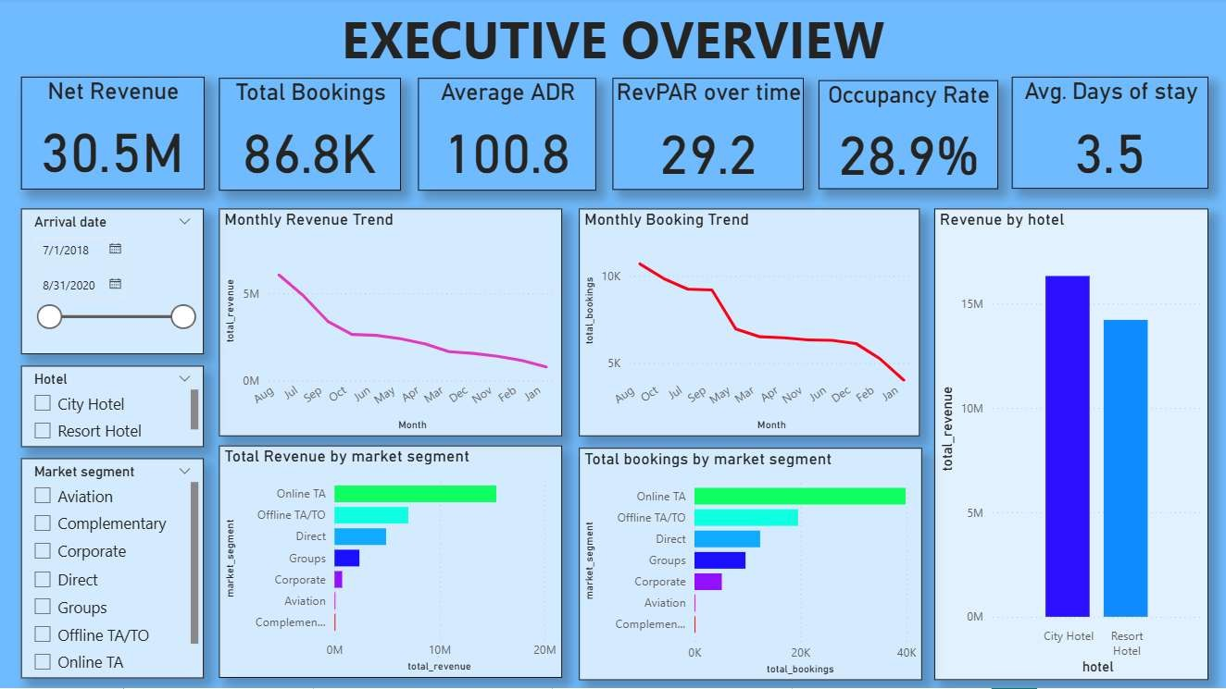


Executive Overview Analysis
30.5M
Total Revenue
Generated 2018-2020
86.8K
Total Bookings
Complete reservations
$100.8
Average Daily Rate
Per room night
28.9%
Occupancy Rate
Rooms filled
3.5
Average Stay
Days per booking
Key Insights
Strong revenue generation demonstrates effective market positioning and demand capture during the analyzed period. The $30.5M revenue reflects consistent booking performance
across both hotel types.
Low occupancy rate (28.9%) indicates significant unused
capacity and potential revenue loss. This suggests opportunities for improved yield management and demand
stimulation strategies.
Seasonal trends visible in monthly revenue patterns show predictable peaks during summer months and holiday seasons, enabling better resource planning and dynamic
pricing implementation.
Conclusion: This indicates that while revenue performance is strong, improving occupancy and leveraging seasonal demand patterns can further enhance overall profitability.

Slide 10
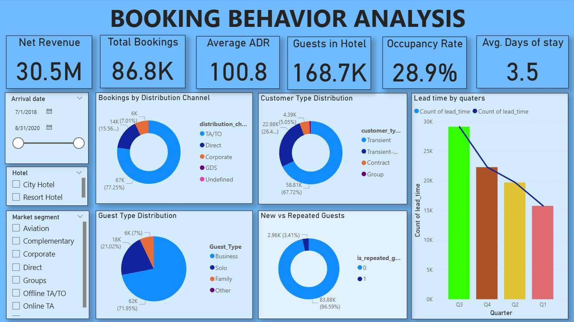


Booking Behavior Analysis
This dashboard focuses on analyzing customer booking behavior and reservation patterns. It helps in understanding how different types of customers interact with hotel booking channels and services.
Key Metrics
Transient customers dominate bookings (~67%)
New customers account for ~96% of total bookings, while repeat customers are very low (~3%)
Travel agents (TA/TO) contribute approximately ~77% of
total bookings
Strategic Insights
The hotel is highly dependent on new customers
Customer retention is significantly low
There is strong reliance on third-party booking platforms
Conclusion: This indicates that improving customer retention and increasing direct bookings are essential for long-term profitability.

Slide 11
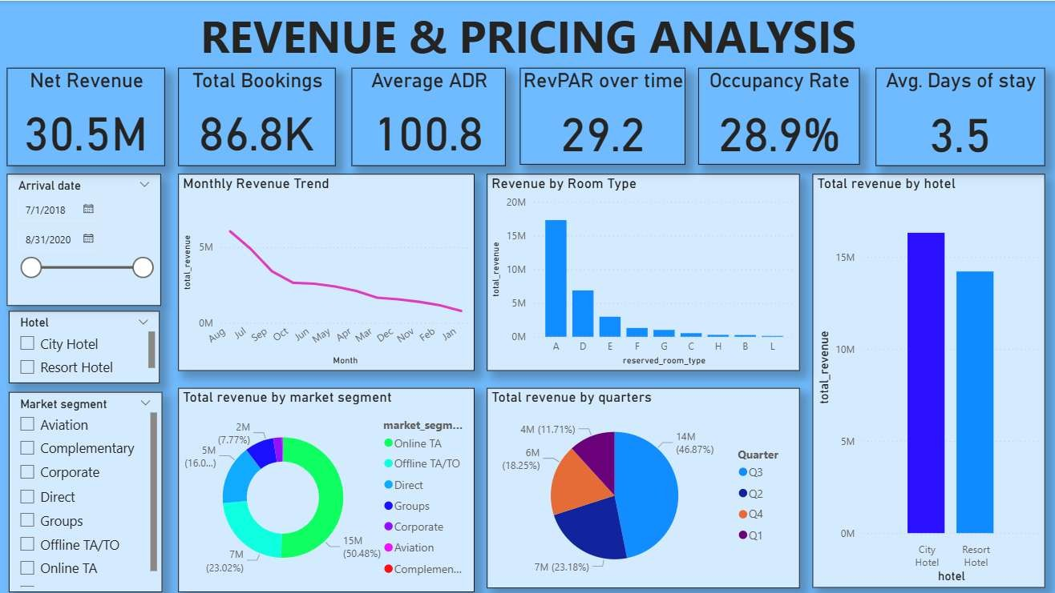


Revenue & Pricing Analysis
Analysis Overview
This analysis focuses on revenue performance and pricing strategy across the hotel portfolio.
Revenue Distribution Analysis
Revenue by hotel type (City vs Resort)
Revenue by room type
Revenue by market segment
Key Insights
City hotels generate higher revenue than resort hotels
Certain room types contribute more revenue
Online TA generates highest revenue (~50%)
Conclusion: This indicates that pricing and demand vary across segments and require optimization.

Slide 12
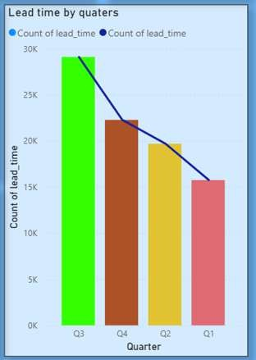

Quarterly Revenue Trends
Revenue Distribution Analysis
Revenue distribution across quarters demonstrates strong seasonal patterns in hotel demand.
Quarterly Breakdown
Q3 contributes highest revenue (~46%)
Q1 contributes lowest revenue
Key Insights
Strong seasonal variation in hotel demand
Peak seasons significantly impact revenue
Conclusion: Hotels should adopt dynamic pricing based on seasonal demand.

Slide 13
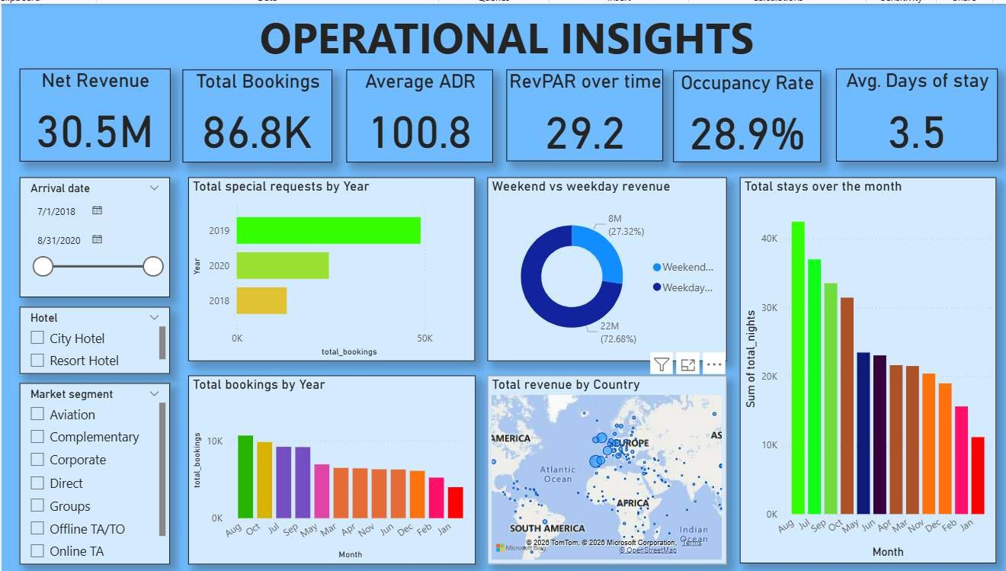

Operational Insights
Stay Pattern Analysis
Operational analysis focuses on stay patterns and revenue distribution across the booking cycle.
Revenue Distribution
Weekday revenue (~73%)
Weekend revenue (~27%)
Average stay: 3.5 days
Key Insights
Business travelers dominate weekday bookings
Weekend occupancy is comparatively low
Short stay duration indicates quick turnover
Conclusion: This indicates that operational performance is heavily driven by weekday business demand, with significant opportunities to improve weekend occupancy and optimize stay duration.

Slide 14
Key Insights
Key findings from the analysis:
Low Occupancy Rate
Despite high revenue generation, occupancy rates remain below optimal levels
Very Low Repeat Customers
Repeat customer rate is approximately ~3%, indicating poor customer retention
High Dependency on Channels
City Hotels as Revenue Drivers
Strong reliance on travel agents and Online TA for bookings
City hotels are the main revenue contributors across all segments
Seasonal Trends
Weekday Dominance
Strong seasonal trends significantly affect overall performance
Weekday bookings dominate over weekend occupancy patterns
Highlight: These insights reveal gaps in customer retention, pricing, and operational efficiency.

Slide 15
Conclusion
This project demonstrates how data analytics helps convert raw hotel booking data into meaningful insights. The use of Power BI for visualization and decision-making enables stakeholders to identify trends, patterns, and opportunities for improvement across all operational dimensions.
Key Takeaways
Revenue performance analysis reveals significant variation across hotel types and market segments
Customer booking behavior understanding shows heavy reliance on new customers and third-party channels
Pricing strategy evaluation indicates need for dynamic pricing based on seasonal demand
Operational insights identification highlights weekday dominance and low weekend occupancy
These insights support data-driven decision-making and help improve overall hotel performance.

